Slide 1

ASP.Net Core
By: Munish Arora

Slide 2
Introduction
In this, we will cover
Evolution Of MVC
Overview
Why MVC
When to use MVC /Web Forms
Installation of MVC 4
Examples

Slide 3
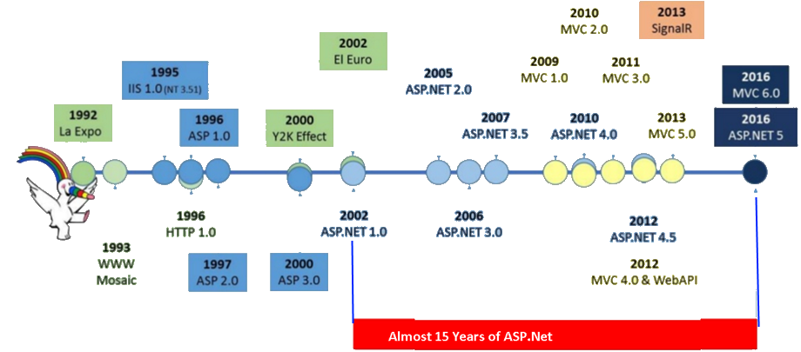
Evolution of .NET Core

Slide 4
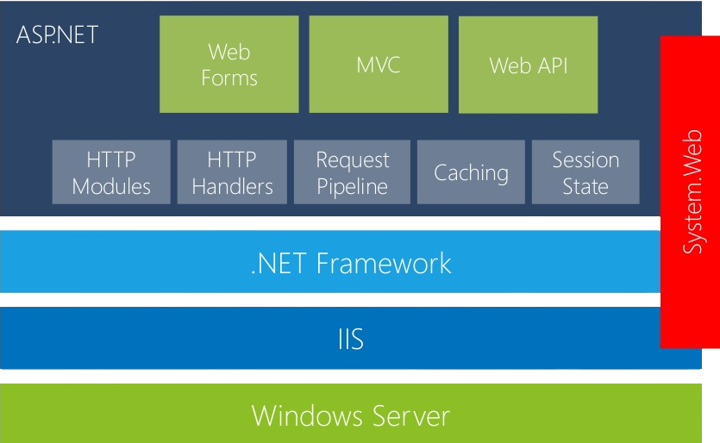
ASP.Net Stack version 4.0 or Earlier
System.Web namespaces contain types that enable browser/server communication
Child namespaces include types that support ASP.NET forms authentication, application services, data caching on the server, ASP.NET application configuration, dynamic data and so on
Notes:
Most of the built-in application programming interfaces (APIs) are part of either System.* or Microsoft.* namespaces.
These class libraries implement many common functions, such as file reading and writing, graphic rendering, database interaction, and XML document manipulation.

Slide 5
Problems with .Net Architecture
Limiting hosting possibilities (IIS only)
Dependency on IIS environment (System.Web)
Resource Incentive: Requires full blown .Net Framework – it's so expensive that typically it consume 30k bytes of memory per request and response
Hard to optimize light high performance apps
System.Web namespace contains types that enable browser/server communication
Child namespaces include types that support ASP.NET forms authentication, application services, data caching on the server etc..

Slide 6
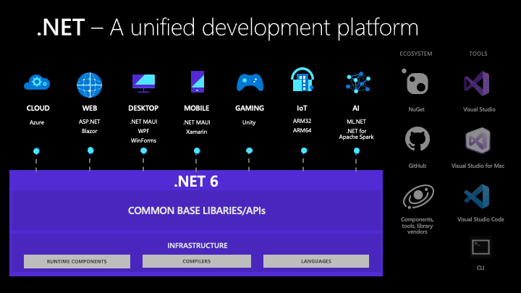
.Net
.NET is a free, open-source development platform for building many kinds of apps, such as Web applications, Desktop Applications, Cloud-native applications, mobile applications, gaming applications etc.
.NET allows development of cross-platform applications

Slide 7
What’s New With ASP.Net Core
Period | Technology | Features
2016 | ASP.Net CORE | It is a complete rewrite of platform The entire dependency on System.web has been done away with. ASP.NET Core apps can run on Windows, OSX, and Linux There has been major performance enhancement of applications where-in you may take only the components that are need for your application, and not loading complete .Net Framework. Multiple deployment Supports Cloud, IIS, Self-Hosting Tag Helpers have been introduced. Tag Helpers are a better alternative to using traditional MVC helpers.

Slide 8
Key Features Of ASP.Net Core
Key Features
Open Source
All sources for ASP.NET Core packages can be found at their GitHub site.
Modularity
Developers have the option to download only the required packages using NuGet Package Manager
Unified MVC and WEB.API
We have a single set of objects within a single namespace (currently Microsoft.AspNet.Mvc). Earlier version used to refer to framework: System.Web.Mvc and System.Web.Http /System.Net.Http,
Dependency Injection and Middleware
Dependency injection is integrated into the framework. It has always been available as an add-on to ASP.NET development by using Microsoft’s own Unity library or a third party library such as Autofac or Ninject.
Cross Platform

Slide 9
.Net Core Support For Other Technologies
.NET Core supports four cross-platform scenarios:
ASP.NET Core web apps
Command-line apps
Libraries and
Universal Windows Platform apps (formerly Windows Store apps and Metro-style apps) that can be used across all compatible MS Windows devices
.NET Core implements Windows Forms, Windows Presentation Foundation (WPF) and and Universal Windows Platform (UWP) on Windows
.NET Core supports use of NuGet packages. Unlike .NET Framework, which is serviced using Windows Update, .NET Core relies on its package manager to receive updates

Slide 10
ASP.Net 5.0
Date | Technology | Features
Nov ’20 | ASP.Net 5.0 | The version 4 has been skipped because it would otherwise confuse users that are familiar with the .NET Framework, which has been using the 4.x series for a long time. It unifies all .NET runtimes into a single .NET platform with unified base class libraries (BCL) for all application models: ASP.NET Core, Windows Forms, WPF, UWP, Xamarin, Blazor.

Slide 11
ASP.Net 6.0
Date | Technology | Features
Nov ’21 | ASP.Net 6.0 | It makes use of C# 10, which reduce the amount of code you need to write the code Better performance: .NET 6 is the fastest full stack web framework(comprising both the front end and the back end), which lowers compute costs if you're running in the cloud. Hot Reload: Make changes to (managed) code while your application is running and apply them without having to pause or stop the application.

Slide 12
Architecture (.Net Framework vs .Net Core)
.Net Framework
.Net Core
ASP.Net
Desktop Apps
ASP.Net Core
(e.g. MVC, EF Core etc)
FCL /BCL
Core FX (.Net Core Class Libraries, Nuget Packages)
CLR Common Language Runtime (JIT Compiler)
CoreCLR Originally, CoreCLR was the runtime of Silverlight and was designed to run on multiple platforms)
Ref: https://docs.microsoft.com/en-us/dotnet/standard/glossary

Slide 13
CORE Common Language Runtime
The CORE Common Language Runtime (CLR) is the environment where all programs in Dot NET Core are run
It has been designed to run on multiple operating systems.
It provides various services, like memory management and thread management
For example, when a program needs a block of memory, CLR provides the block and releases the block when program is done with the block.

Slide 14
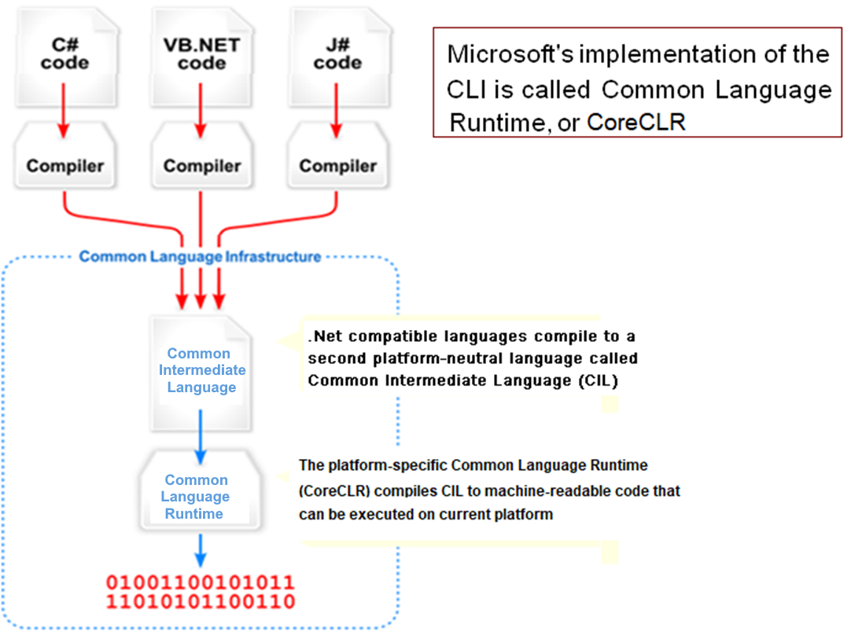
Architecture: Common Language Infrastructure (CLI)
The purpose of the Common Language Infrastructure (CLI) is to provide a language-neutral platform for application development and execution
MSIL
Notes:
Compiling the source code to MSIL assemblies using the language compiler. Compiling the source code using the language compiler generates the corresponding assembly containing the MSIL. The assembly can be either a .exe or a .dll depending on the entry point defined in the Application.
Executing the code by CLR The operating system loader checks the COFF (The Common Object File Format (COFF) is a format for executable, object code, and shared library computer files) header for a managed module. When a bit in the COFF header is set on then that denotes a managed module. If the loader detects a managed module it loads mscoree.dll which denotes the runtime execution engine; mscoree.dll loads and executes the .Net assemblies.

Slide 15
CORE Common Language Runtime
All programs targeted to .NET are converted to MSIL (Microsoft Intermediate Language). MSIL is the output of language compilers in .NET CORE
MSIL is then converted to native code by JIT (Just-in Time Compiler) of the CLR and then native code is run by CLR.
The code that is run under CLR is called Managed code.

Slide 16
How .Net Core works?
Question:
Is CoreCLR Operating System specific?
Can ASP.Net Core code be written to take different execution paths depending upon current execution environment /operating system ?
Answer:
When you create a build, A particular build of CORE CLR will only work on one OS, because it has been compiled to use features from that OS (including the OS-specific compiler, linking against the right OS-specific libraries, and running code specific to handle that OS).
There is also a Platform Abstraction Layer in CoreCLR and the PAL layer converts it to the right syscalls on Linux and Mac.

Slide 17


Knowledge check
Why was .Net Core as a complete rewrite of existing platform required?
Select all that apply.
To support multiple Operating Systems
To allow side-by-side deployment of applications
To get rid of dependency on System.web dll
csproj file contains the list of files included in a project.
True
False

Slide 18
Knowledge Check
CoreCLR is the . NET execution engine in . NET Core, originally developed in Silverlight, performs functions such as garbage collection and compilation to machine code
True
False

Slide 19
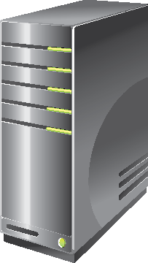
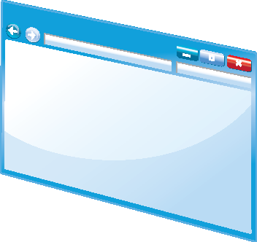


Overview of ASP.NET and ASP.NET Core
When you use ASP.NET to build an application, you are not restricted to a single style of programming. Instead, you can choose from several different programming models.
Some programming models are available only in ASP.NET 4.x, some are available only in ASP.NET Core and some are available in both ASP.NET 4.x and ASP.NET Core.
You can build the application using
Web Pages
Web Forms
MVC (Available in ASP.Net4.x and ASP.Net Core)
ASP.NET
HTML
Pages

Slide 20
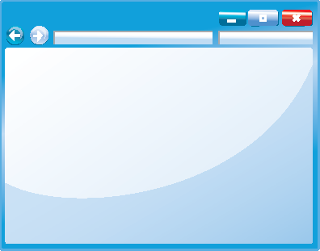


Client-Side Web Technologies
JavaScript
jQuery
AJAX
Angular
React
And more
<p>
Content
</p>
p {
color: black;
}

Slide 21

Hosting
Every website must be hosted by a web server.
A web server receives requests for web content from browsers, runs any server-side code, and returns web pages, images, and other content.
HTTP is used for communication between the web browser and the web server.
IIS
IIS is a web server that can scale up from a small website running on a single web server to a large website running on a multiple web server farms.
IIS is available with Windows Server.

Slide 22
Hosting
IIS Express
Internet Information Services Express is a lightweight version of IIS, which is optimized for development and testing. IIS Express does not provide all the features of IIS on Windows Server
Other Web Servers
Apache is a popular non-Microsoft web server and there are other alternatives such as Nginx.
Both can be installed on Windows Server or Windows client computers to host websites during development or for production deployments.
Azure: Can be deployed on Azure.

Slide 23
Hosting
Azure:
Flexible Scaling
Flexible Pricing: You can go for Pay as You Go
Worldwide presence
First Class Security

Slide 24
.Net Core vs .Net Framework
.Net Core | .Net Framework
You want your code to run cross-platform | You want to extend an existing application that uses .NET Framework
You want to create microservices that can be deployed to multiple operating systems | You want to use NuGet packages or third-party .NET libraries that are not supported in .NET Core
You want to use Docker containers | You want to use .NET technologies that aren't supported in .NET Core. For example ASP.NET Web Forms, ASP.NET Web Pages applications, WCF server implementation, Workflow-related services, Language Support (VB and F#)

Slide 25
.Net Core vs .Net Framework
.Net Core | .Net Framework
Side by side .NET versions per application level This side-by-side installation allows multiple services on the same server, each of them on its own version of .NET Core/5+. | Platform doesn't support .NET Core/5+ Some Microsoft or third-party platforms don't support .NET Core/5+.
For details pls. refer to https://docs.microsoft.com/en-us/dotnet/standard/choosing-core-framework-server

Slide 26

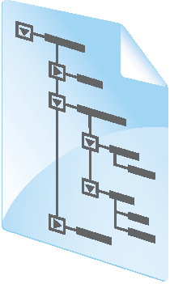


MVC Architecture
SQL
View
Model
Database
Controller
Response
HTTP
Web Server
Browser

Slide 27
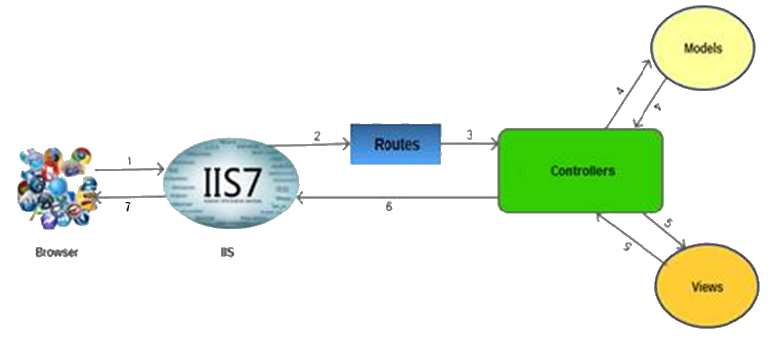
MVC Architecture
The browser (as usual) sends a request to IIS.
IIS searches for the route defined in MVC application and passes the request to the controller as per route.
The controller communicates with the model and passes the populated model (entity) to View (front end)
Views are populated with model properties, and are rendered on the browser through IIS via controllers which invoked the particular View.
Notes:
(formerlyWindows Store apps and Metro-style apps) areapplications that can be used across all compatible Microsoft Windows devices, including personal computers (PCs), tablets, smartphones, Xbox One, Microsoft HoloLens, and Internet of Things.

Slide 28
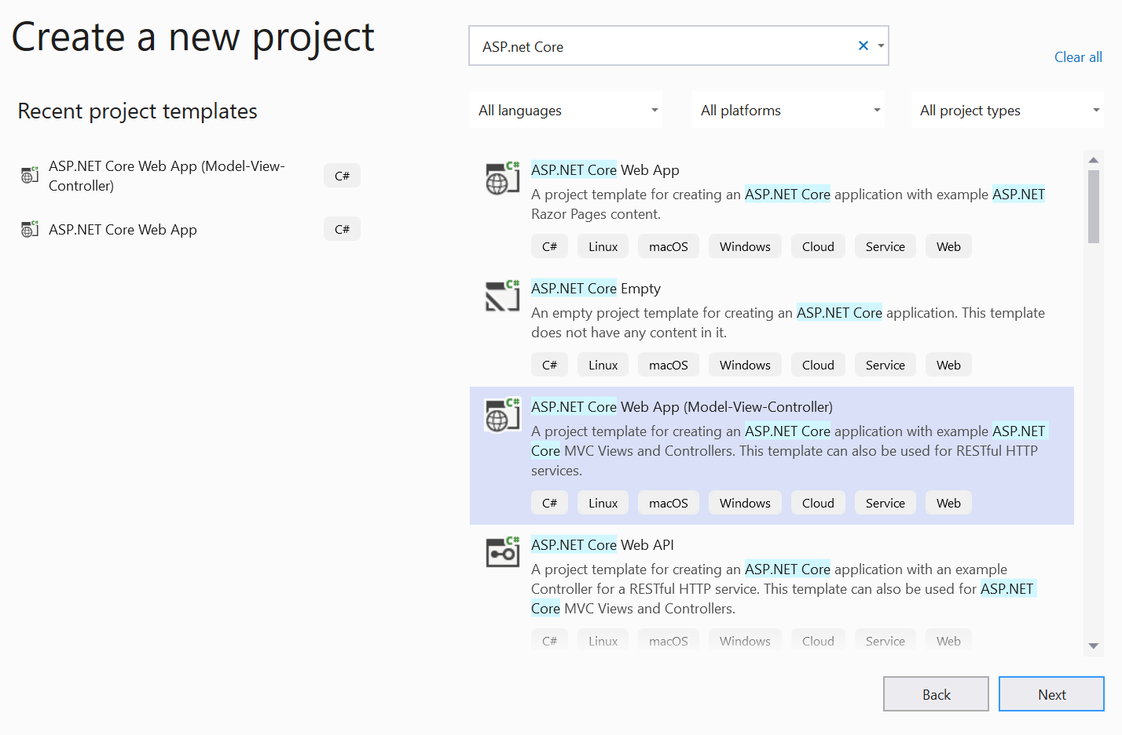
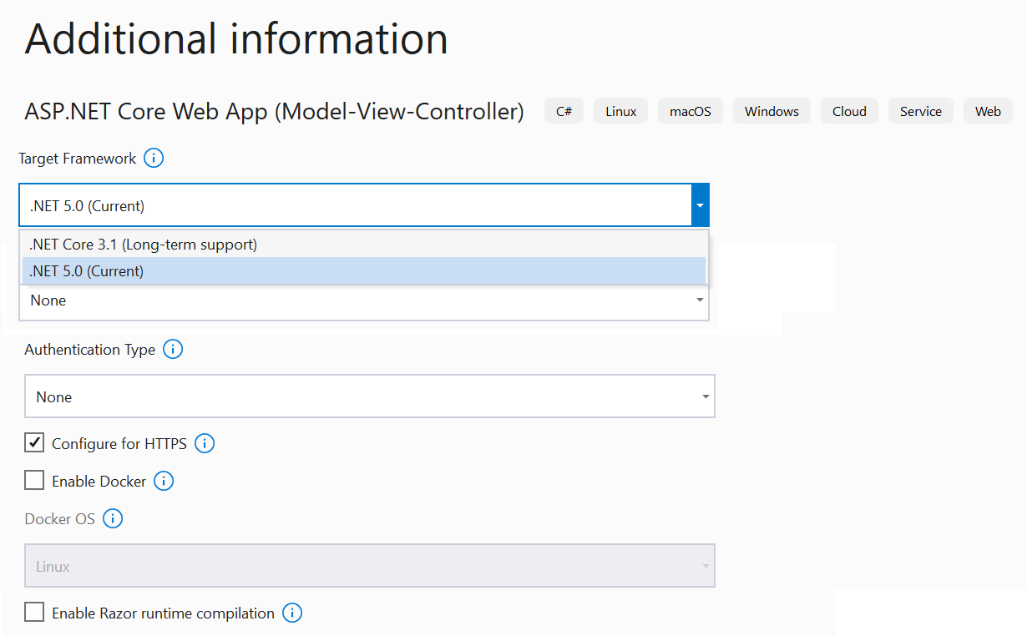
Types Of Applications
Type Of Application | Description
Template of Application (Empty /ASP.Net Core (MVC), or any other) | Project Template for creating Applications. This cab be deployed to windows , Linux or Mac OS

Slide 29
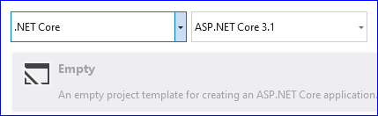
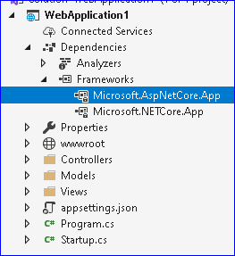
Types Of Applications
If you create an empty web project for both ASP.Net Core or .net framework, it will reference the following libraries
for building modern, cloud-based web apps on Windows, macOS, or Linux.

Slide 30
Shared Framework
The ASP.NET Core shared framework (Microsoft.AspNetCore.App) contains assemblies that are developed and supported by Microsoft. Microsoft.AspNetCore.App is installed when the .NET Core 3.0 or later SDK is installed.
There are two shared frameworks.
Framework name | Description
Microsoft.NETCore.App | The base runtime. It supports things like System.Object , List<T>, string, memory management, file and network IO, threading, etc.
Microsoft.AspNetCore.App | The default web runtime. It imports Microsoft.NETCore.App, and adds API to build an HTTP server using Kestrel, Mvc, SignalR, Razor, and parts of EF Core.

Slide 31
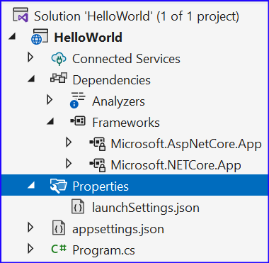
Folder Structure
When you create an empty project, you will see the folders/files as follows
Folder | Details
Connected Services | Via this you may connect to 3rd party services like WCF service
Dependencies | All referenced Nuget packages are listed here
launchSettings.json | These are environment settings which you can also modify using Project | Properties| debug
appsettings.json | For saving configuration settings, like database connection string, etc
Program.cs | Code in Program.cs is entry point to the application. This code inside program.cs is converted to main method.

Slide 32
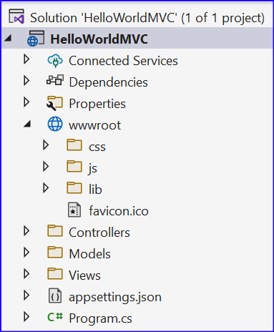
Folder Structure
You usually create the folders to support your MVC application.
Some of the folders you may include are as follows
Folder | Details
wwwroot | Static files, which includes HTML files, CSS files, image files, and JavaScript files, are assets that the app serves directly to clients, are saved in this folder
Controllers | For Storing Controllers
Models | Contains Model Class which represent the application models. Model Classes are used for data manipulation
Data | For Data Migration components
Services | You may create your own services like send Mail, SMSSender etc and store them in this folder

Slide 33
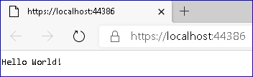
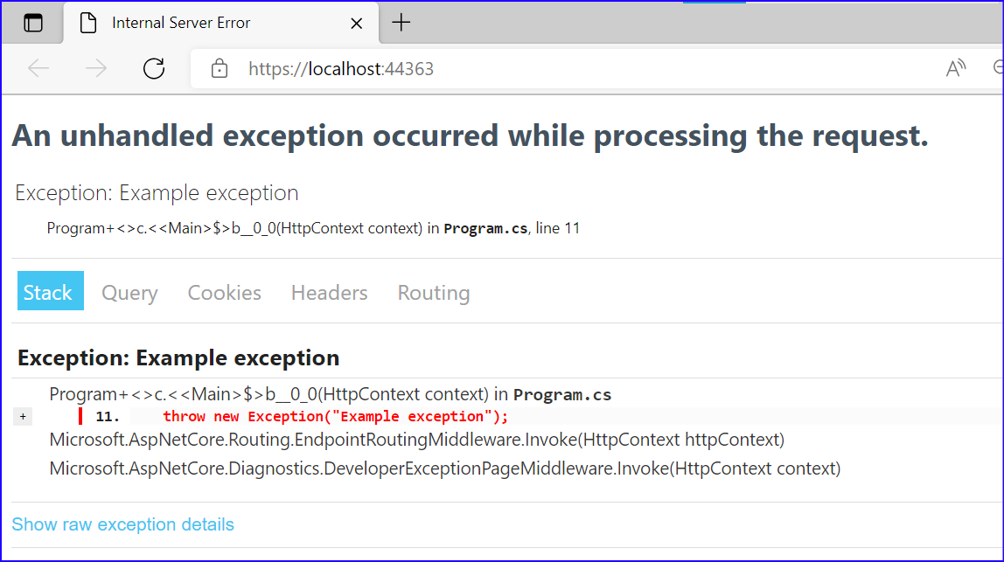
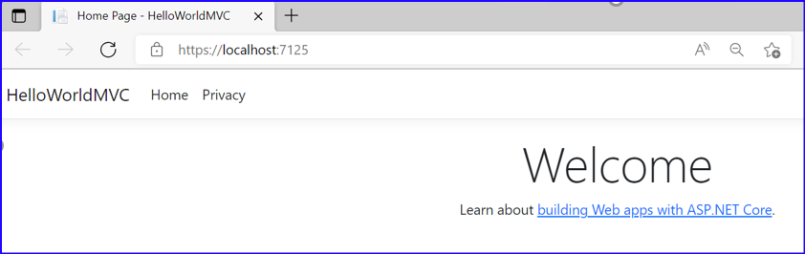
Demo: HelloWorld!!
1 HelloWorld Application
1.1 Create Application
1.2 Raising Exception
1.3 Decompiling The Code
2 ASP.Net Core MVC Application

Slide 34
Middleware in ASP.Net Core
Middleware was firstly introduced in ASP.NET Core 1.0 (Q1 2016).
Middleware is components of an application that examine the requests responses coming into and coming out from an ASP.NET Core application.
Middleware can be thought of as both HTTP modules and handlers that we've had in classic ASP.NET.
Some middleware would implement various intermediate tasks when processing requests such as authentication, session state retrieval and persistence, logging and so on
Some others would be the ultimate request handlers that would produce responses.

Slide 35
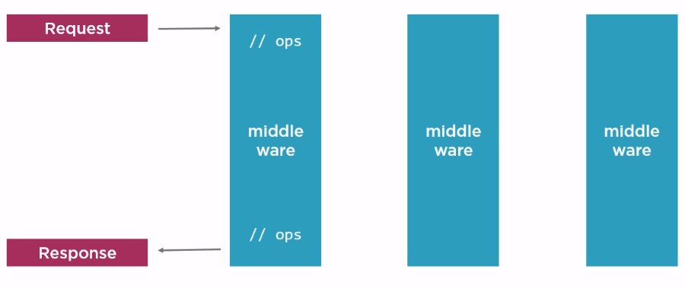
Middleware in ASP.Net Core
With ASP.Net Core, we can inject middleware, in what is known as request pipeline
Every request has to pass through this request pipeline (/Middlewares)

Slide 36
Middleware
At each step, the middleware may or may not pass to next middleware. Eg let’s say first middleware is authentication middleware, here we may check if authentication succeeds and only then it passes to the next level, otherwise unauthorized exception is raised.

Slide 37
Middleware
So, the workflow will be as shown in the diagram below follows
HTTP Request
IIS
.Net Core
CLR
Main()
Configure()
App Code
HTTP Response
Middleware
Middleware

Slide 38
Middleware
Following are some commonly used Built-in Middlewares
1. Exception Handling:
a. UseDeveloperExceptionPage() & UseDatabaseErrorPage(): used in development phase to catch run-time exceptions.
b. UseExceptionHandler(): used in production for run-time exceptions
Calling these methods first ensures that exceptions are caught.
2. Cookie Policy:
a. UseCookiePolicy(): used to enforce cookie policy and display GDPR-friendly messaging

Slide 39
Middleware
3. HSTS & HTTPS Redirection:
a. UseHsts(): used in production to enable HSTS (HTTP Strict Transport Security Protocol) and enforce HTTPS.
b. UseHttpsRedirection(): forces HTTP calls to automatically redirect to equivalent HTTPS addresses.
Calling these methods next ensure that HTTPS can be enforced before resources are served from a web browser.
4. Static files:
a. UseStaticFiles(): used to enable static files, such as HTML, JavaScript, CSS and graphics files.
This Middleware is called early on to avoid the need for authentication, session or MVC middleware.

Slide 40
Middleware
5. Authentication, Authorization & Sessions:
a. UseAuthentication(): used to enable authentication and then subsequently allow authorization.
b. UserSession(): manually added to the Startup file to enable the Session middleware.
Calling these after cookie authentication (but before the MVC middleware) ensures that cookies can be issued as necessary and that the user can be authenticated before the MVC engine kicks in.
6. MVC & Routing:
a. UseMvc(): enables the use of MVC in your web application, with the ability to customize routes for your MVC application and set other options.

Slide 41
Middleware
7. routes.MapRoute(): set the default route and any custom routes when using MVC.

Slide 42
Knowledge check
Code in Program.cs is a replacement of Global.asax file in ASP.NET Web Form application, and is more about registering services and injection of modules in HTTP pipeline.
True
False
Which of the following is true?
Middlewares are added in Startup method in program.cs
Middlewares are added in in program.cs
Pipeline is created in program.cs

Slide 43
Middleware
We may also have Kestrel, working as a reverse proxy web server
HTTP Request
IIS
.Net Core
CLR
Kestrel
Main()
Configure()
App Code
HTTP Response
Middleware
Middleware

Slide 44
What is Kestrel
Kestrel is a open source cross-platform web server based on libuv, a cross-platform asynchronous I/O library.
Kestrel is designed to be run behind a proxy (for example IIS or Nginx)
ASP.NET Core ships with two different HTTP servers:
Microsoft.AspNetCore.Server.Kestrel (AKA Kestrel, cross-platform)
Microsoft.AspNetCore.Server.HttpSys (which contains Microsoft.AspNetCore.Server.WebListener and Microsoft.Net.Http.Server)
The default web host for ASP.NET apps developed using Visual Studio is IIS Express

Slide 45
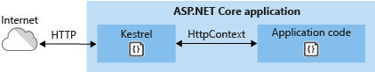
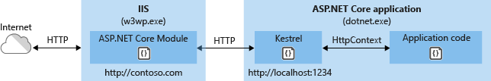
What is Kestrel
We may make use of Kestrel as a direct server or as a reverse proxy server for IIS Express
Reverse Proxy Server
A reverse proxy server is a type of proxy server that retrieves resources on behalf of a client from one or more servers. These resources are then returned to the client like they originated from the Web server itself.]

Slide 46
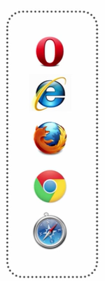
HttpPlatformHandler
IIS Express
App
Kestrel
HttpPlatformHandler, essentially, forward all requests to Kestrel.
IIS Express (and IIS for that matter) will not run ASP.NET themselves anymore. Instead, they will act as proxies that simply pass requests and responses back and forth from Kestrel.
HttpPlatformHandler, essentially, forward all requests to Kestrel.
There is still advantage of using IIS, specifically it gives you security configuration, kernel-level caching, etc

Slide 47
Why Kestrel and IIS?
ASP.NET Core & Kestrel combined are a whole new request pipeline for how ASP.NET requests work.
Changed Roles
HTTP modules & handlers have been replaced with simple middleware (IIS and Kestrel).
Security is being handled by IIS, as earlier
Kestrel is working as Full Fledged web server
Performance and Speed:
Kestrel makes use of async operations, thereby improving the performance
The entire System.Web namespace is gone. So, no longer dependency on Windows based operating systems
Cross Platform
As a developer, I can write my ASP.NET application and deploy it to Windows or Linux either one. Kestrel works as my web server on both. However, it is still recommended to use IIS, Apache, or NGINX as a reverse proxy in front of it.

Slide 48
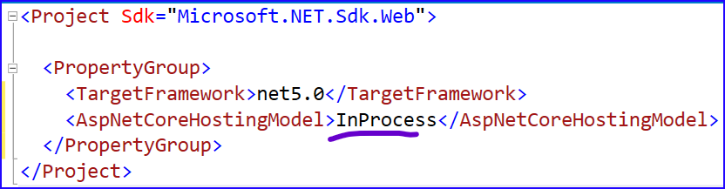
Hosting Model
There are 2 hosting models:
InProcess Hosting (Host an ASP.NET Core app inside of the IIS worker process (w3wp.exe), called the in-process hosting model.). So, essentially iis worker process is managing the application.
OutOfProcess Hosting (Forward web requests to a backend ASP.NET Core app running the Kestrel server, called the out-of-process hosting model.)
ASP.NET Core apps default to the in-process hosting model.
In .csProj, we have the section for hosting model
If the <AspNetCoreHostingModel> property isn't present in the file, the default value is InProcess.

Slide 49
Hosting Model
Reference:
In-process hosting with IIS and ASP.NET Core | Microsoft Docs
Out-of-process hosting with IIS and ASP.NET Core | Microsoft Docs

Slide 50
Demo: Hosting Model
Analyze the different Hosting Models by
1 Create Default Project
2 Hosting Model
2.1 Using Command Line
2.2 In-Process Hosting
2.2.1 Using Visual Studio
2.2.2 Using IISExpress
2.3 Out of Process Hosting
2.3.1 Using Visual Studio
2.3.2 From IIS Express:
2.4 Running as PrjHostingModel (same as Command Line)

Slide 51
Knowledge check
InProcess Hosting will use Kestrel Engine
True
False
ASP.NET Core apps default to the in-process hosting model.
True
False

Slide 52
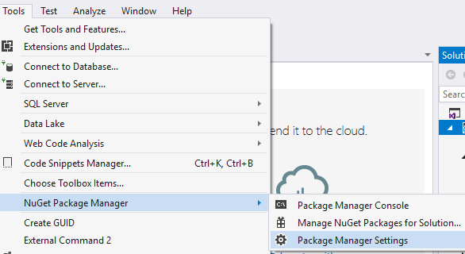
Configure nuget
You may download nugget packages from internet (configured by default) or when you install .Net Core these packages are added by default The usual location is C:\Program Files (x86)\Microsoft SDKs\NuGetPackages
To specify the location as package source, go to Tools | Nuget Package Manager | Package Manager Settings

Slide 53
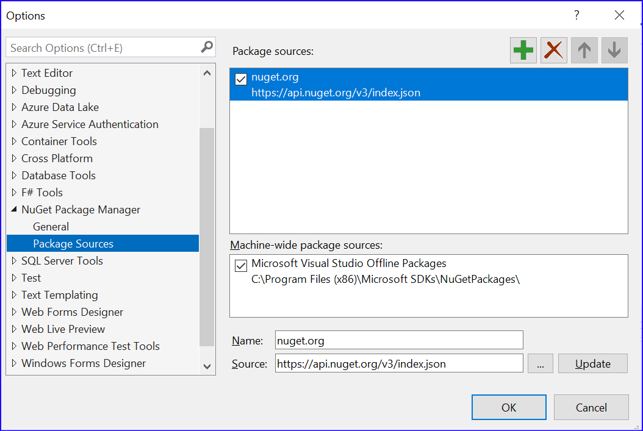
Configure nuget
And Click on button
Give it a name and specify the source, and click on update button, and then OK button.

Slide 54
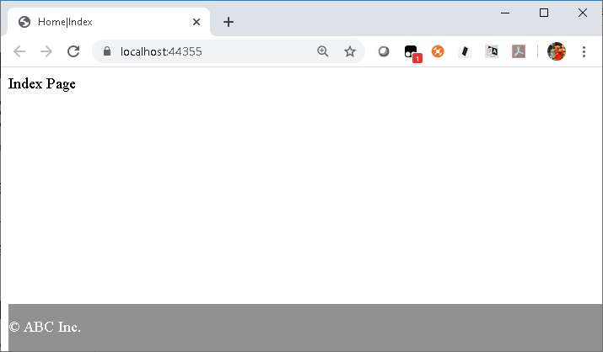
Demo: MVC Application
Let us create an ASP.Net Core MVC Application
When this is run, it by default invokes the controller, and default action

Slide 55
New Features: Tag Helper
Tag Helpers is the one feature that might have the biggest impact on the way that you create your views in an ASP.NET MVC application. Tag Helpers are a better alternative to using traditional MVC helpers.
Consider the following MVC view that contains a form for creating a new product:
@model MyProject.Models.Product
@using (Html.BeginForm())
{
<div>
@Html.LabelFor(m => p.Name, "Name:")
@Html.TextBoxFor(m => p.Name)
</div>
<input type="submit" value="Create" />
}

Slide 56
New Features: Tag Helper
In the view above, the Html.BeginForm(), Html.LabelFor(), and Html.TextBoxFor() helpers are used to create the form. These helpers would not be familiar to an HTML designer.
Here’s how the exact same form can be created by using Tag Helpers:
What’s So Special: These asp-for attributes are used to extend the elements with server-side ASP.NET MVC functionality.
@model MyProject.Models.Product
@addtaghelper "Microsoft.AspNet.Mvc.TagHelpers"
<form asp-controller="Products" asp-action="Create" method="post">
<div>
<label asp-for="Name">Name:</label>
<input asp-for="Name" />
</div>
<input type="submit" value="Save" />
</form>

Slide 57
New Features: View Components
With ASP.Net Core, we have View Components, instead of subcontrollers
In previous versions of ASP.NET MVC,
You used the Html.Action() helper to invoke a subcontroller.
Html.Action() helper — is not included in the current version of MVC 6. MVC 6 includes an alternative technology called View Components.
public class Employee {
public int id { get; set; }
public string Name { get; set; }
}
then, use Html.Action passing the parameters:
Html.Action("EmpAction", new { Employee = new Employee { id=1, Name="ABC"} })
and in Controller:
public ActionResult EmpAction(Employee Employee) {
return PartialView(Employee);
}

Slide 58
New Features: View Components
Here’s how you can create a View Component that displays one of two banner advertisements depending on the time of day:
using Microsoft.AspNet.Mvc;
using System;
namespace Partials.Components{
public class BannerAd : ViewComponent{
public IViewComponentResult Invoke(){
var adText = "Buy more coffee!";
if (DateTime.Now.Hour > 18){
adText = "Buy more warm milk!";
}
return View("_Advertisement", adText);
}
}
}

Slide 59
New Features: View Components
If the time is before 5:00pm then the View Component returns a partial named _Advertisement with the advertisement text “Buy more coffee!”. If the time is after 5:00pm then the text changes to “Buy more warm milk!”.
Here’s what the _Advertisement partial looks like:
Finally, here is how you can use the BannerAd View Component in an MVC view:
View Components are very similar to subcontrollers. However, subcontrollers were always a little odd. They were pretending to be controller actions but they were not really controller actions. View Components just seem more natural.
@model string
<div style="border:2px solid green;padding:15px">
@Model
</div>
@Component.Invoke("BannerAd")

Slide 60
ASP.Net Core: New Features
ASP.NET Identity: The MVC project templates have been updated to use ASP.NET Identity (e.g. Facebook and Google authentication, OAuth and OpenId) for authentication and identity management.
Bootstrap: The MVC project template has been updated to use Bootstrap to provide a sleek and responsive look and feel that you can easily customize.
Authentication filters: Authentication filters are a new kind of filter in ASP.NET MVC that run prior to authorization filters in the ASP.NET MVC pipeline and allow you to specify authentication logic per-action, per-controller, or globally for all controllers.

Slide 61
GruntJS and NPM Support
For Front Developers, there is support for
GruntJS is a task runner that enables you to build front-end resources such as JavaScript and CSS files. For example, you can use GruntJS to concatenate and minify your JavaScript files whenever you perform a build in Visual Studio.
NPM Packages: In order to support GruntJS, Microsoft needed to support two new package managers (beyond NuGet). First, because GruntJS plugins are distributed as NPM packages, Microsoft added support for NPM packages.

Slide 62
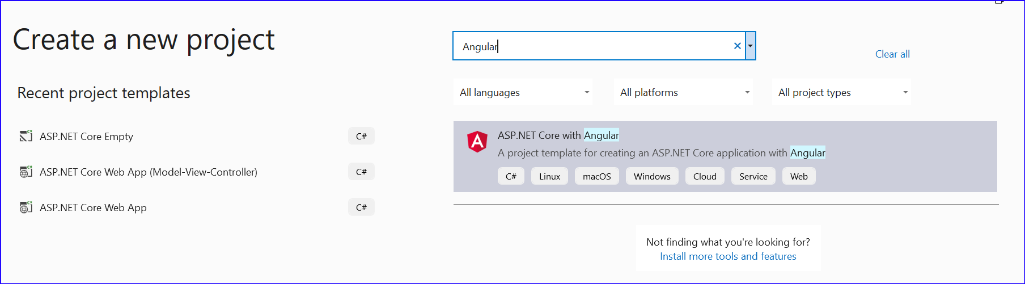
ASP.Net Core: New Features: Angular
AngularJS is one of the most popular client-side frameworks for building Single Page Applications (SPAs).
Visual Studio includes templates for creating AngularJS modules, controllers, directives, and factories.

Slide 63
Dependency Injection Framework
Dependency Injection is a way to implement the Dependency Inversion Principle
Simply put, Dependency Injection is a design pattern that helps a class separate the logic of creating dependent objects
ASP.NET Core has built-in support for Dependency Injection and the Service Locator pattern.
This means that you no longer need to rely on third-party Dependency Injection frameworks such as Ninject or AutoFac.
For example, you have created an IRepository interface and an EFRepository class that implements that interface.
In that case, you can bind the EFRepository class to the IRepository interface in the ConfigureServices() method of the Startup.cs class like this:
services.AddTransient<IRepository, EFRepository>();

Slide 64
Dependency Injection Framework
After you bind EFRepository and IRepository then you can use constructor dependency injection in your MVC controllers (and any other class) using code like this:
In the code above, the IRepository interface is passed to the constructor for the ProductsController.
The built-in ASP.NET Dependency Injection framework passes EFRepository to the ProductsController because IRepository was bound to EFRepository.
public class ProductsController : Controller{
private IRepository _repo;
public ProductsController(IRepository repo){
_repo = repo;
}
}

Slide 65
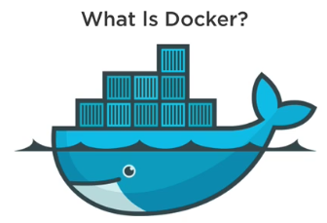
Docker Support
Lightweight, Open Secure Platform
Shipping container for the code
Simplify building, shipping, running apps
Runs natively on Windows server and Linux server
Runs on Windows or Mac Development Machine
Relies on images and containers

Slide 66
THANK YOU!

